Slide 1
Unit 1 Lab
Basic Web Exploits

Slide 2

Overview
Prerequisites
Basic HTTP, Encoding
Focus Areas
URL Manipulation, Insecure Direct Object Reference
Tools
Burp Suite, Cyber Shepherd
Challenges
Challenge 2 Walk Through

Slide 3
Prerequisites
Basic HTTP
Request and Response
HTTP Methods
HTTP Headers
Query Parameters
Encoding

Slide 4
Focus Areas
URL Manipulation
When editing a URL, it can revel private information or allow access to data that should be restricted.
Enumerating values in a database.
Searching for new webpages.
Example:
If someone adds http://mypage.com/post1?preview=true
This may show an unpublished version of a webpage

Slide 5
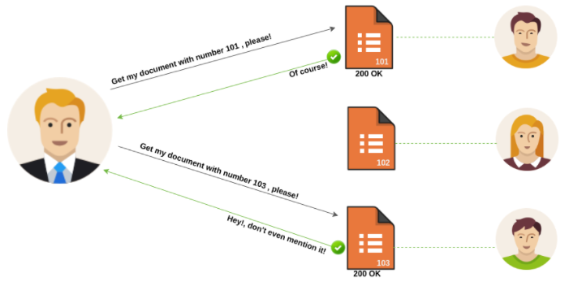
Focus Areas
Insecure Direct Object Reference
When code access a restricted input based on user input but fails to verify the authorization.
There is now a direct reference to an internal resource.

Slide 6
Focus Areas
How it works:
You are sent a personal promo code http:/test.com/applydiscount?promo=111 which displays during check out:
Applied Discount = 20%
But now your curious to see if there is another discount available by changing the parameter “promo code” to :/applydiscount?promo=124 or /applydiscount?promo=150 which displays during check out:
Applied Discount = 50% (Or 75%)

Slide 7
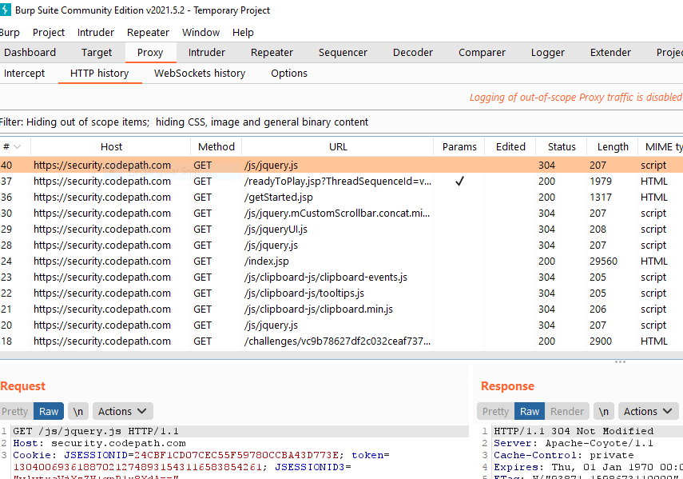

Tools
Burp Suite
CodePath Security Shepherd
  Used for web application security testing.
  Video walk through to install Burp Suite
  Security Training platform

Slide 8

Other Tools
Intruder
Change parameters that you set that will help you
cycle through a list of different things.
(In other words, it can also be used for brute force)
Repeater
Used to manually modify the HTTP request and
to playback request to the server.
(Will show example on next slides)
Decode
Used to encode or decode symbols.
HTTP History
Contains a table of all HTTP messages passed through the Proxy.

Slide 9
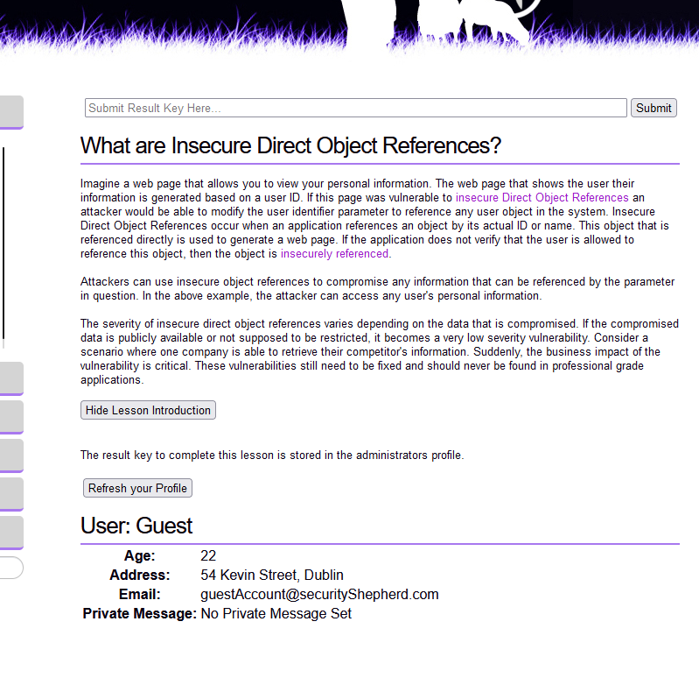

Challenges
Walk Through: Challenge 2 Insecure Direct Object References (IDOR)
1. Click on “Refresh your Profile”

Slide 10
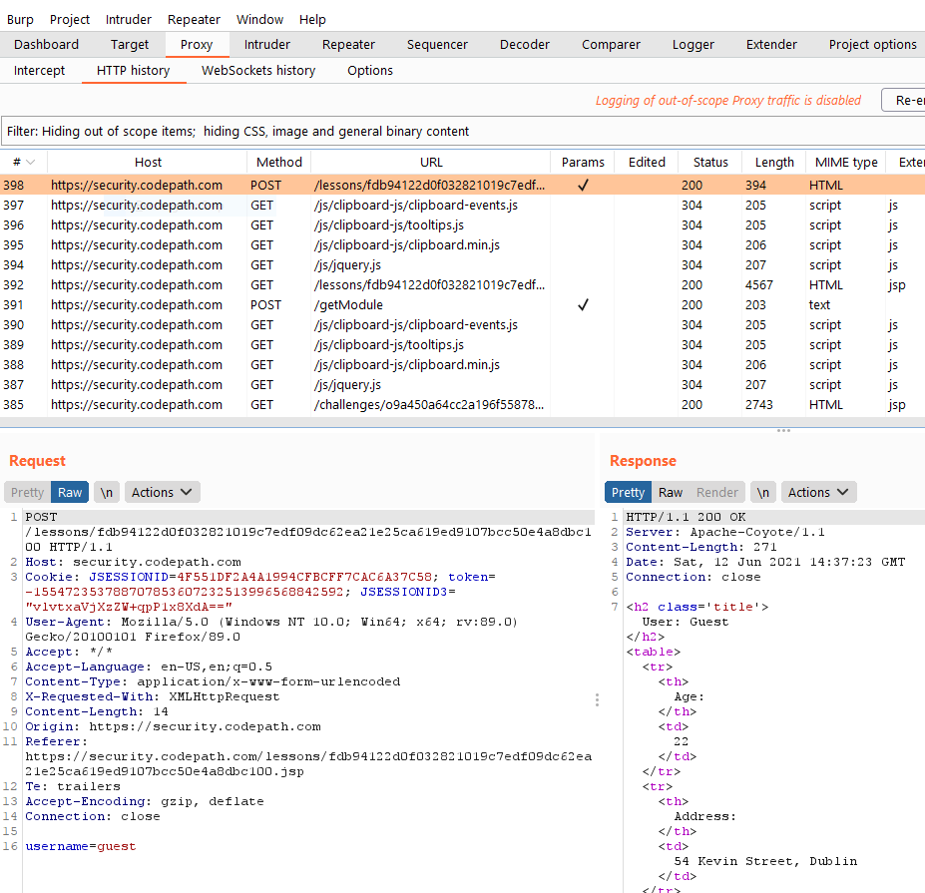
Challenges
2. Navigate to your Burp Suite
3. Right click on the first URL
4. Click “Send to Repeater”

Slide 11
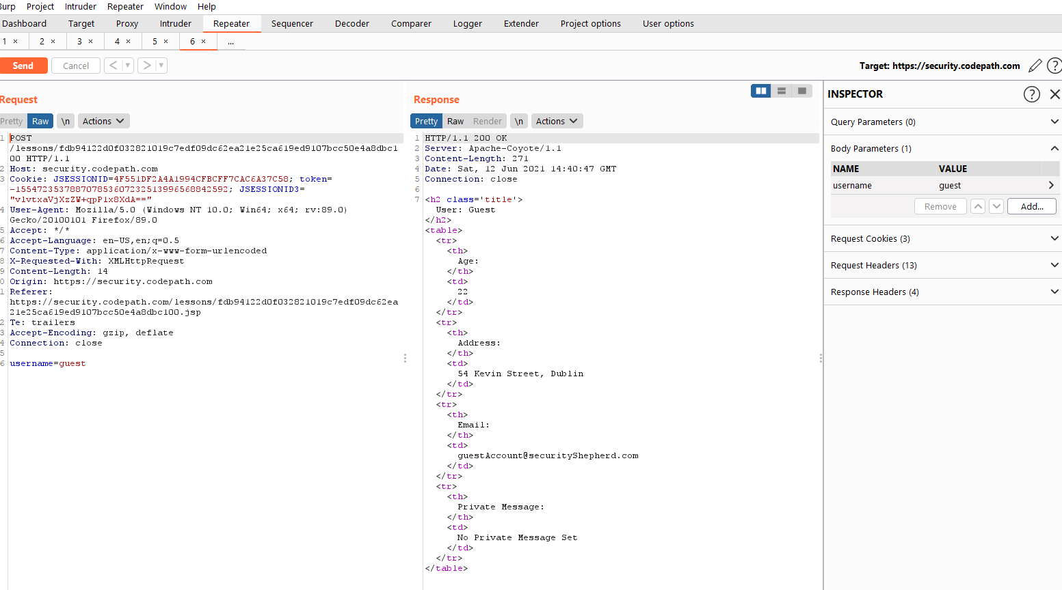
Challenges
5. Click “Send”
After you click “Send”, read the
Response section.
6. Go to “Inspector”
7. Go to “Body Parameter”
8. Click on “Add”
Step 8

Slide 12
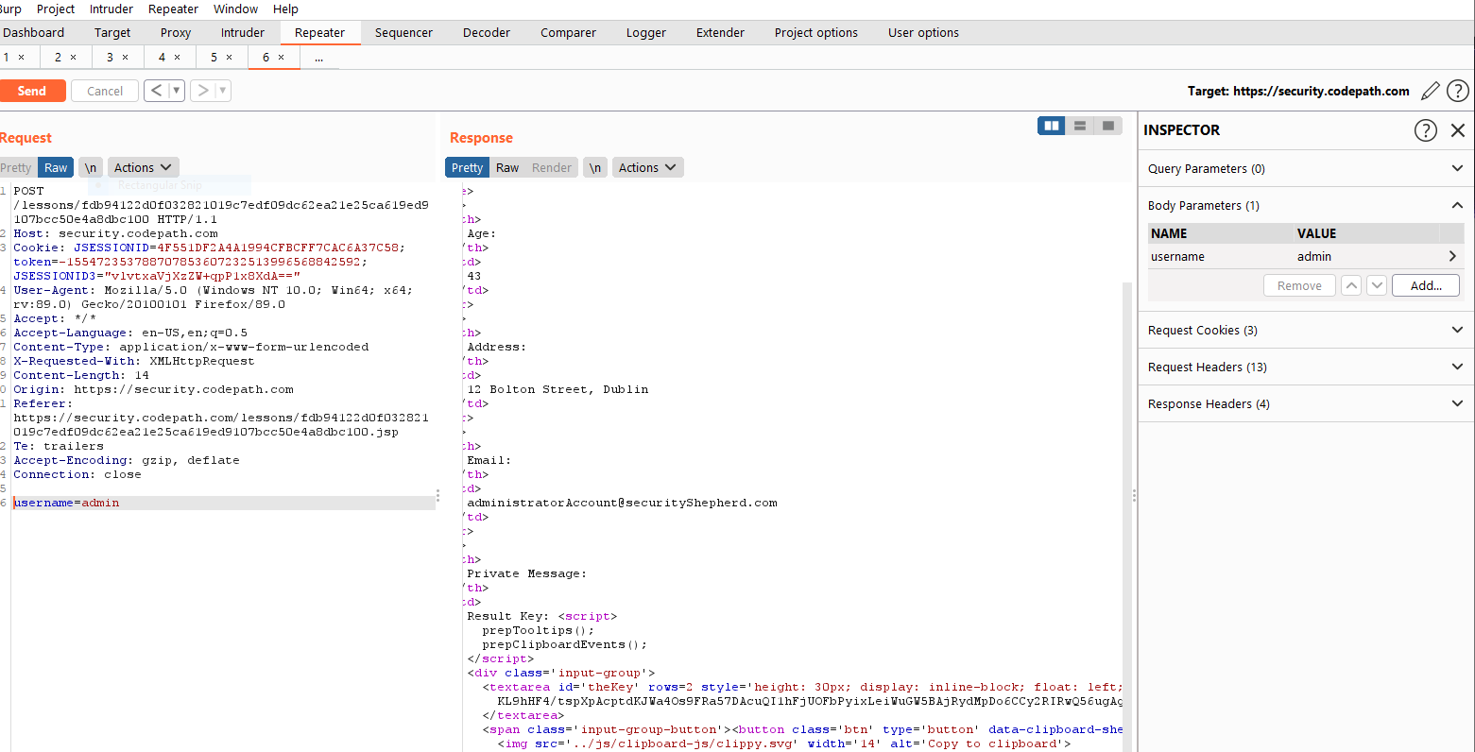
Challenges
9. Under “Name” type username and
under “Value” type “admin”
Look at the “Request” section
10. Remove username=guest and type
“username=admin”
11. Click “Send” on the top left
12. In “Response” look at the key and
copy it
Step 11
Step 9
Step 10
Step 12

Slide 13
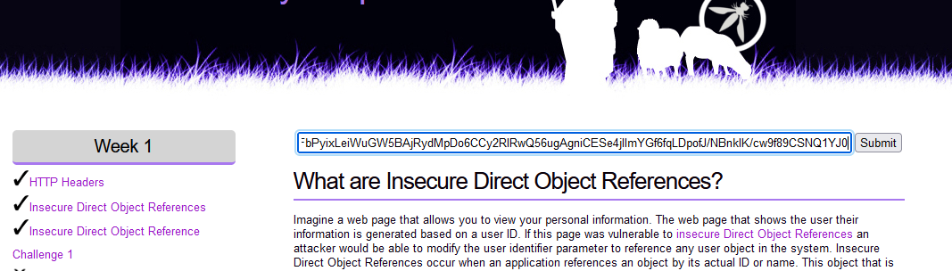
Challenges
13. Paste it into Cyber Shepherd
14. Click “submit”

